Slide 1
Software Engineering and Architecture
Pattern Catalog: Decorator

Slide 2
New Requirement
Alphatown wants to log all coin entries:
  [time] [value]
Example:
  14:05:12 5 cent
  14:05:14 25 cent
  14:55:10 25 cent
☺

Slide 3
The 3-1-2 machinery
Let us look at the machinery:
③ Identify the responsibility whose concrete behaviour may vary
① Express responsibility as an interface
② Composition: “Let someone else do the job”
How does this apply?
What is 3-1-2 here?

Slide 4
Analysis
③ Identify the responsibility whose concrete behaviour may vary
  It is the “Accept payment” responsibility
① Express responsibility as an interface
  A) PaymentAcceptPayment role? Cohesion???
  B) PayStation role? Already in place!
② Let someone else do the job
  Maybe let someone handle the coins before the parking machine receives them?

Slide 5

Metaphor: Principle 2
Introduce an intermediate person/object

Slide 6

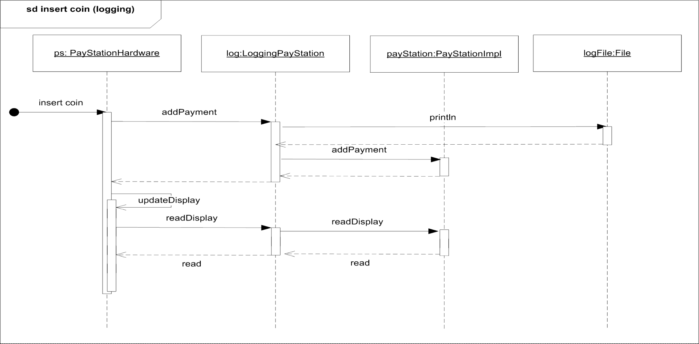
Dynamics

Slide 7
[Demo]
Refactoring process – solution first programming
  Establish basis: run TestPayStation
  ps = new LogDecoratedPS( ps );
  In LogDecoratePS do
    Intro ‘private PayStation delegate;’
    Select it, and choose menu ‘Code/Delegate methods…’
  Rerun tests
  Introduce the decorating statement in the LogDec…
  ”Flip the reference” to enable/disable at runtime

Slide 8
Flip Reference
We can ‘flip’ the reference at run-time
  Will we call methods on one or the other
payStation
(reference)
payStation object
Logging ON

Slide 9
Flip Reference
We can ‘flip’ the reference at run-time
  Will we call methods on one or the other
payStation
(reference)
payStation object
Logging OFF

Slide 10
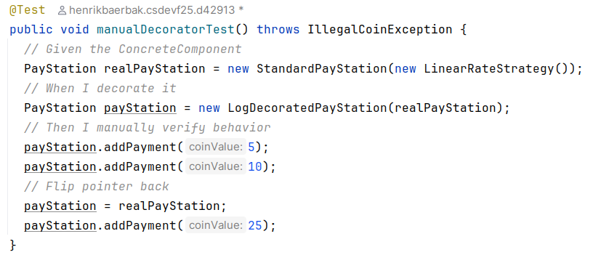
As In…
‘Flipping’ code

Slide 11
Decorator Pattern

Slide 12
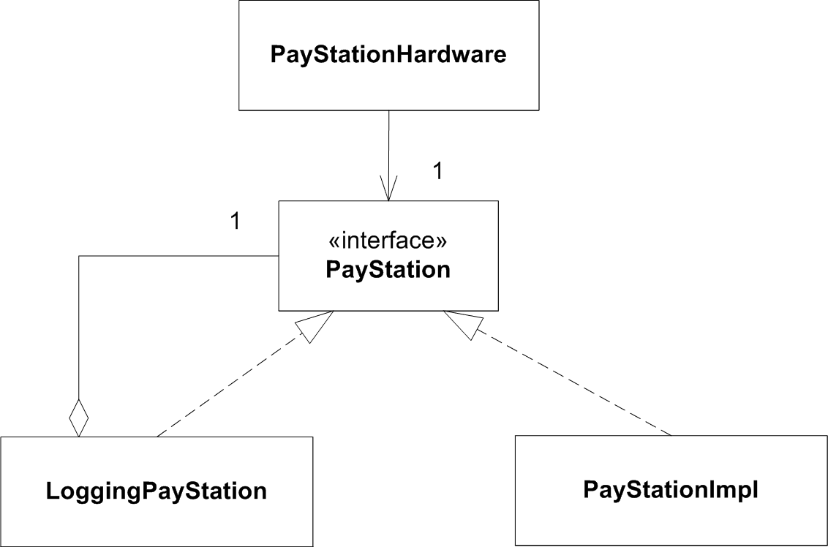
Structure

Slide 13
Chaining decorators
Decorators can form chains.
New requirement:
  no payment possible in 19.00 – 07.00 interval
:PayStationCoinLoggingDecorator
:PayStationFreeParkingInterval
:PayStationImpl

Slide 14
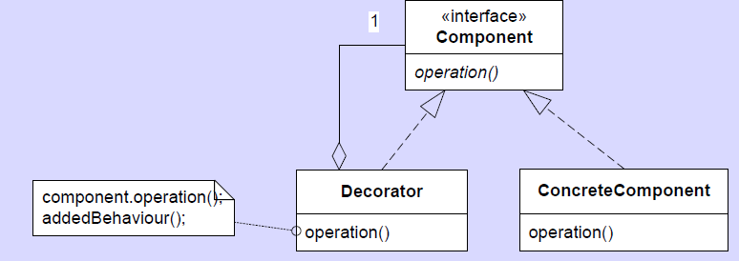
Automagical pattern?
The decorator is yet another application of 3-1-2 and the principles of flexible design!

Slide 15
Consequences
Benefits
  Adding and removing behavior at run-time
  Incrementally add responsibilities
  Complex behavior by chaining decorators
Liabilities
  Analyzability suffers as you end up with lots of little objects
    Behavior is constructed at run-time instead of being written in the static code
  Delegation code tedious to write (without IDE ☺)
    Make a ‘null decorator’ as base class

